Slide 1
AVL Trees
Instructor: Bostan Khan

Slide 2
AVL Trees Data Structure
An AVL tree defined as a self-balancing Binary Search Tree (BST) where the difference between heights of left and right subtrees for any node cannot be more than one.
Named after its inventors, Georgy Adelson-Velsky and Evgenii Landis, who published it in their 1962 paper “An algorithm for the organization of information”.
The difference between the heights of the right subtree and the left subtree for any node is known as the balance factor of the node.
Source: AVL Tree Data Structure - GeeksforGeeks

Slide 3
Balance Factor
The Balance Factor for a node is the difference in height between its right and left subtrees.
BF(X)=height(rightSubtree(X))−height(leftSubtree(X))
The only difference between a regular Binary Search Tree and an AVL Tree is that AVL Trees do rotation operations in addition, to keep the tree balance.
A Binary Search Tree is in balance when the difference in height between left and right subtrees is less than 2.
By keeping balance, the AVL Tree ensures a minimum tree height, which means that search, insert, and delete operations can be done really fast.
Source: DSA AVL Trees (w3schools.com)

Slide 4
Balance Factor
The Balance Factor for a node is the difference in height between its right and left subtrees.
BF(X)=height(rightSubtree(X))−height(leftSubtree(X))
Balance factor values
0: The node is in balance.
more than 0: The node is "right heavy".
less than 0: The node is "left heavy".
If the balance factor is less than -1, or more than 1, for one or more nodes in the tree, the tree is considered not in balance, and a rotation operation is needed to restore balance.
Source: DSA AVL Trees (w3schools.com)

Slide 5
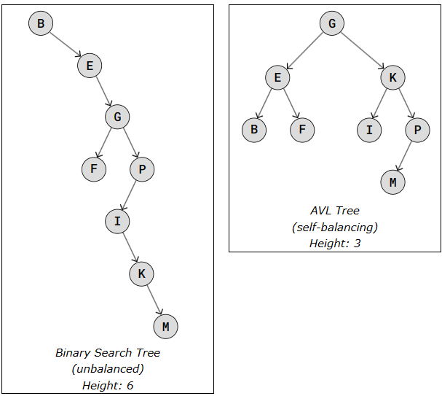
AVL Trees Data Structure
The two trees on the right are both Binary Search Trees, they have the same nodes, and the same in-order traversal (alphabetical), but the height is very different because the AVL Tree has balanced itself.
A Binary Search Tree is in balance when the difference in height between left and right subtrees is less than 2.
The two trees on the right are both Binary Search Trees, they have the same nodes, and the same in-order traversal (alphabetical), but the height is very different because the AVL Tree has balanced itself.
Source: DSA AVL Trees (w3schools.com)

Slide 6
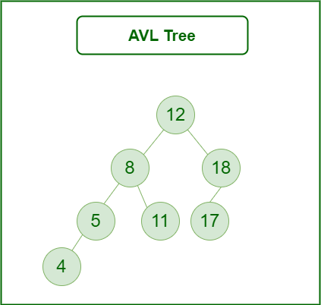
AVL Trees Data Structure
The tree on the right is AVL because the differences between the heights of left and right subtrees for every node are less than or equal to 1.
Source: AVL Tree Data Structure - GeeksforGeeks

Slide 7
AVL Trees Data Structure
If, at any time after a modification, the heights violate this property, rebalancing is performed to restore the property.
The balancing is performed by rotating subtrees to adjust the heights and maintain the balance factor.
AVL trees are crucial in computer science for their efficient insertion, deletion, and lookup operations, all with time complexities of O(log n), where n is the number of nodes in the tree.
This makes AVL trees useful in applications where efficient searching and retrieval of data are critical.

Slide 8
Balancing AVL Trees
To keep AVL trees balanced after an insertion or a deletion, an AVL tree may rotate in one of the following four ways:
Left Rotation
Right Rotation
Left-Right Rotation
Right-Left Rotation
Source: AVL Tree Data Structure - GeeksforGeeks

Slide 9
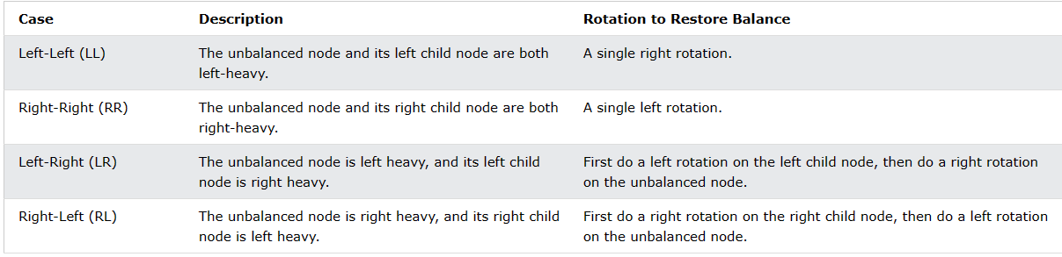
Balancing AVL Trees
Source: DSA AVL Trees (w3schools.com)

Slide 10
Balancing AVL Trees
Source: DSA AVL Trees (w3schools.com)

Slide 11
Balancing AVL Trees
Source: DSA AVL Trees (w3schools.com)

Slide 12
Balancing AVL Trees
Source: DSA AVL Trees (w3schools.com)

Slide 13
Balancing AVL Trees
Source: DSA AVL Trees (w3schools.com)

Slide 14
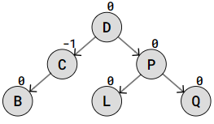
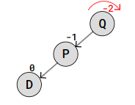
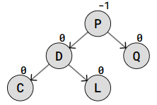
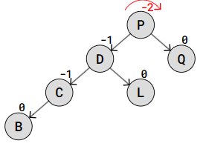
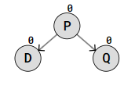
The Left-Left (LL) Case
Balanced Tree
The node where the unbalance is discovered is left heavy, and the node's left child node is also left heavy.
When this LL case happens, a single right rotation on the unbalanced node is enough to restore balance.
Add Nodes
Add node
Balanced Tree
Still Balanced Tree
Unbalanced Tree
Perform Right Rotation
Unbalanced Tree
Perform Right Rotation
Source: DSA AVL Trees (w3schools.com)

Slide 15
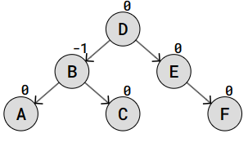
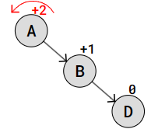
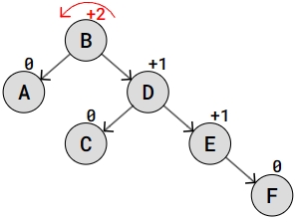
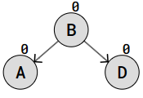
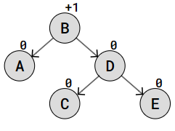
The Right-Right (RR) Case
Balanced Tree
A Right-Right case happens when a node is unbalanced and right heavy, and the right child node is also right heavy.
A single left rotation at the unbalanced node is enough to restore balance in the RR case.
Add node
Add Nodes
Unbalanced Tree
Perform Left Rotation
Balanced Tree
Still Balanced Tree
Unbalanced Tree
Perform Left Rotation
Source: DSA AVL Trees (w3schools.com)

Slide 16
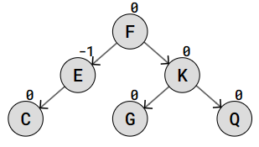
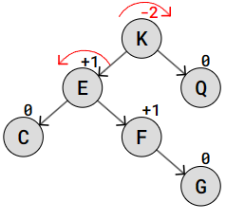
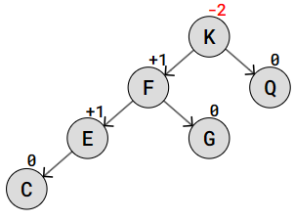
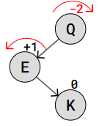
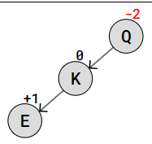
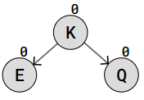
The Left-Right (LR) Case
Balanced Tree
The Left-Right case is when the unbalanced node is left heavy, but its left child node is right heavy.
In this LR case, a left rotation is first done on the left child node, and then a right rotation is done on the original unbalanced node.
Right Rotation
Left Rotation
Tree Balanced
Add nodes
Unbalanced Tree
Perform Left Rotation
Tree Still Unbalanced
Perform Right Rotation
Source: DSA AVL Trees (w3schools.com)
Tree again unbalanced

Slide 17
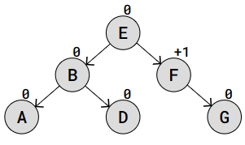
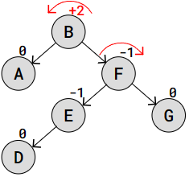
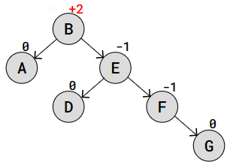
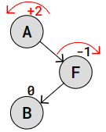
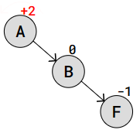
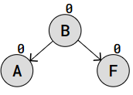
The Right-Left (RL) Case
The Right-Left case is when the unbalanced node is right heavy, and its right child node is left heavy.
In this case we first do a right rotation on the unbalanced node's right child, and then we do a left rotation on the unbalanced node itself.
Left Rotation
Right Rotation
Tree Balanced
Add nodes
Unbalanced Tree
Perform Right Rotation
Tree Still Unbalanced
Perform Left Rotation
Tree again unbalanced
Source: DSA AVL Trees (w3schools.com)

Slide 18
Implementation for Insertion and Balancing of AVL Trees

Slide 19
#include<bits/stdc++.h>
using namespace std;
// An AVL tree node
class Node
{
public:
int key;
Node *left;
Node *right;
int height;
};
// A utility function to get the
// height of the tree
int height(Node *N)
{
if (N == NULL)
return 0;
return N->height;
}
// A utility function to get maximum
// of two integers
int max(int a, int b)
{
return (a > b)? a : b;
}
Node* newNode(int key)
{
Node* node = new Node();
node->key = key;
node->left = NULL;
node->right = NULL;
node->height = 1; // new node is initially
// added at leaf
return(node);
}
// A utility function to right
// rotate subtree rooted with y
// See the diagram given above.
Node *rightRotate(Node *y)
{
Node *x = y->left;
Node *T2 = x->right;
// Perform rotation
x->right = y;
y->left = T2;
// Update heights
y->height = max(height(y->left),
height(y->right)) + 1;
x->height = max(height(x->left),
height(x->right)) + 1;
// Return new root
return x;}
Function for Right Rotation
Source: Insertion in an AVL Tree - GeeksforGeeks

Slide 20
Node *leftRotate(Node *x)
{
Node *y = x->right;
Node *T2 = y->left;
// Perform rotation
y->left = x;
x->right = T2;
// Update heights
x->height = max(height(x->left),
height(x->right)) + 1;
y->height = max(height(y->left),
height(y->right)) + 1;
// Return new root
return y;
}
// Get Balance factor of node N
int getBalance(Node *N)
{
if (N == NULL)
return 0;
return height(N->left) - height(N->right);
}
// Recursive function to insert a key
// in the subtree rooted with node and
// returns the new root of the subtree.
Node* insert(Node* node, int key)
{
/* 1. Perform the normal BST insertion */
if (node == NULL)
return(newNode(key));
if (key < node->key)
node->left = insert(node->left, key);
else if (key > node->key)
node->right = insert(node->right, key);
else // Equal keys are not allowed in BST
return node;
/* 2. Update height of this ancestor node */
node->height = 1 + max(height(node->left),
height(node->right));
/* 3. Get the balance factor of this ancestor
node to check whether this node became
unbalanced */
int balance = getBalance(node);
Function for Left Rotation
Source: Insertion in an AVL Tree - GeeksforGeeks

Slide 21
if (balance > 1 && key < node->left->key)
return rightRotate(node);
// Right Right Case
if (balance < -1 && key > node->right->key)
return leftRotate(node);
// Left Right Case
if (balance > 1 && key > node->left->key)
{
node->left = leftRotate(node->left);
return rightRotate(node);
}
// Right Left Case
if (balance < -1 && key < node->right->key)
{
node->right = rightRotate(node->right);
return leftRotate(node);
}
/* return the (unchanged) node pointer */
return node;
}
// A utility function to print preorder
// traversal of the tree.
// The function also prints height
// of every node
void preOrder(Node *root)
{
if(root != NULL)
{
cout << root->key << " ";
preOrder(root->left);
preOrder(root->right);
}
}
Source: Insertion in an AVL Tree - GeeksforGeeks

Slide 22
// Driver Code
int main()
{
Node *root = NULL;
/* Constructing tree given in
the above figure */
root = insert(root, 10);
root = insert(root, 20);
root = insert(root, 30);
root = insert(root, 40);
root = insert(root, 50);
root = insert(root, 25);
/* The constructed AVL Tree would be
30
/ \
20 40
/ \ \
10 25 50
*/
cout << "Preorder traversal of the "
"constructed AVL tree is \n";
preOrder(root);
return 0;
}
Source: Insertion in an AVL Tree - GeeksforGeeks

Slide 23
Implementation for Deletion and Balancing of AVL Trees

Slide 24
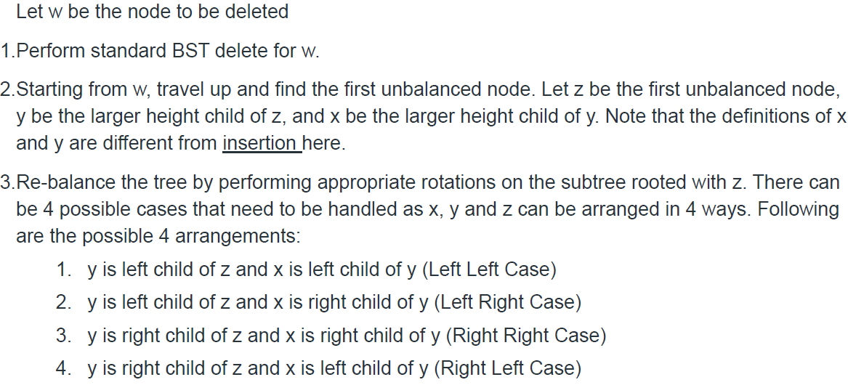
Deletion

Slide 25
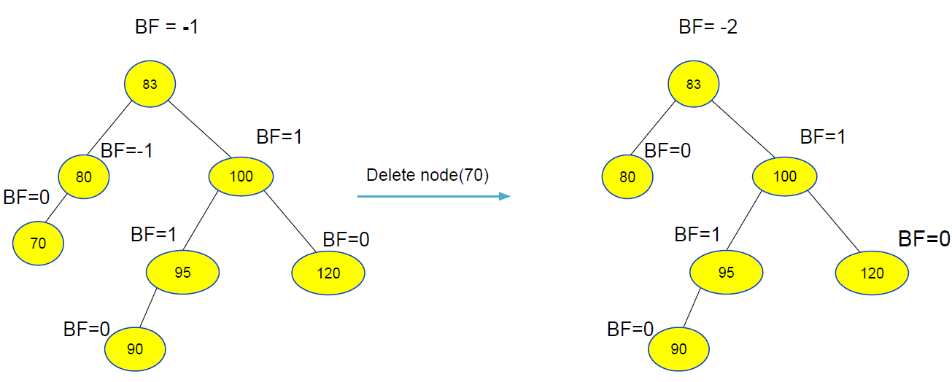
Deletion (case: Right- left Rotation)

Slide 26
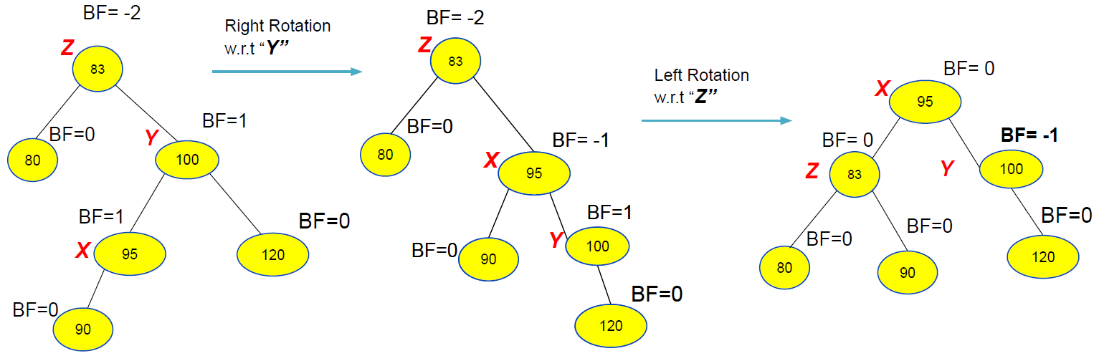
Deletion (case: Right- left Rotation)

Slide 27
// C++ program to delete a node from AVL Tree
#include<bits/stdc++.h>
using namespace std;
// An AVL tree node
class Node
{
public:
int key;
Node *left;
Node *right;
int height;
};
// A utility function to get maximum
// of two integers
int max(int a, int b);
// A utility function to get height
// of the tree
int height(Node *N)
{
if (N == NULL)
return 0;
return N->height;
}
// A utility function to get maximum
// of two integers
int max(int a, int b)
{
return (a > b)? a : b;
}
/* Helper function that allocates a
new node with the given key and
NULL left and right pointers. */
Node* newNode(int key)
{
Node* node = new Node();
node->key = key;
node->left = NULL;
node->right = NULL;
node->height = 1; // new node is initially
// added at leaf
return(node);
}
Source: Deletion in an AVL Tree - GeeksforGeeks

Slide 28
Node *rightRotate(Node *y)
{
Node *x = y->left;
Node *T2 = x->right;
// Perform rotation
x->right = y;
y->left = T2;
// Update heights
y->height = max(height(y->left),
height(y->right)) + 1;
x->height = max(height(x->left),
height(x->right)) + 1;
// Return new root
return x;
}
Node * minValueNode(Node* node)
{
Node* current = node;
/* loop down to find the leftmost leaf */
while (current->left != NULL)
current = current->left;
return current;
}
Node *leftRotate(Node *x)
{
Node *y = x->right;
Node *T2 = y->left;
// Perform rotation
y->left = x;
x->right = T2;
// Update heights
x->height = max(height(x->left),
height(x->right)) + 1;
y->height = max(height(y->left),
height(y->right)) + 1;
// Return new root
return y;
}
// Get Balance factor of node N
int getBalance(Node *N)
{
if (N == NULL)
return 0;
return height(N->left) -
height(N->right);}
Source: Deletion in an AVL Tree - GeeksforGeeks

Slide 29
Node* deleteNode(Node* root, int key)
{
// STEP 1: PERFORM STANDARD BST DELETE
if (root == NULL)
return root;
// If the key to be deleted is smaller
// than the root's key, then it lies
// in left subtree
if ( key < root->key )
root->left = deleteNode(root->left, key);
// If the key to be deleted is greater
// than the root's key, then it lies
// in right subtree
else if( key > root->key )
root->right = deleteNode(root->right, key);
// if key is same as root's key, then
// This is the node to be deleted
else
{
// node with only one child or no child
if( (root->left == NULL) ||
(root->right == NULL) )
{
Node *temp = root->left ?
root->left :
root->right;
// No child case
if (temp == NULL)
{
temp = root;
root = NULL;
}
else // One child case
*root = *temp; // Copy the contents of
// the non-empty child
free(temp);
}
else
{
// node with two children: Get the inorder
// successor (smallest in the right subtree)
Node* temp = minValueNode(root->right);
// Copy the inorder successor's
// data to this node
root->key = temp->key;
// Delete the inorder successor
root->right = deleteNode(root->right,
temp->key);
}
}
Source: Deletion in an AVL Tree - GeeksforGeeks

Slide 30
// If the tree had only one node
// then return
if (root == NULL)
return root;
// STEP 2: UPDATE HEIGHT OF THE CURRENT NODE
root->height = 1 + max(height(root->left),
height(root->right));
// STEP 3: GET THE BALANCE FACTOR OF
// THIS NODE (to check whether this
// node became unbalanced)
int balance = getBalance(root);
// If this node becomes unbalanced,
// then there are 4 cases
// Left Left Case
if (balance > 1 &&
getBalance(root->left) >= 0)
return rightRotate(root);
// Left Right Case
if (balance > 1 &&
getBalance(root->left) < 0)
{
root->left = leftRotate(root->left);
return rightRotate(root);
}
// Right Right Case
if (balance < -1 &&
getBalance(root->right) <= 0)
return leftRotate(root);
// Right Left Case
if (balance < -1 &&
getBalance(root->right) > 0)
{
root->right = rightRotate(root->right);
return leftRotate(root);
}
return root;
}
Source: Deletion in an AVL Tree - GeeksforGeeks

